Slide 1
BIOMEDIN 215 Data Driven Medicine
Nigam Shah, MBBS, PhD
nigam@stanford.edu

Slide 2
Previous class:
There are models for different kinds of data
Use hierarchical or autoregressive models for correlated outcomes
Recognize multiple hypothesis scenarios and accordingly adjust p-values

Slide 3
Questions for today
How to choose between multiple models
How to empirically calibrate confidence intervals and p-values using studies with known results (positive and negative controls)
Putting it all together to design a good study

Slide 4
Model Selection

Slide 5
You have data (Y, X₁, X₂) and decide to fit two models:
1)
2)
You’re interested in β₁. The two models give different estimates and confidence intervals. What do you do?
Quietly write down any strategies you think of
Notes:
Call on people, write their strategies on the board and organize them in a way that they reflect the next few slides

Slide 6
Comparing Likelihoods or “Goodness of Fit”
Models are fit by maximizing a likelihood.
Why not compare the likelihood of the data given each model and pick the best?
Examples :
F-test (nested models)
Compare R² (proportion of variance explained)

Slide 7
What’s wrong with comparing goodness-of-fit?
Notes:
Call on people, write their strategies on the board and organize them in a way that they reflect the next few slides

Slide 8
Problem: you can always improve your fit by adding more parameters or complexity to your model (overfitting)

Slide 9
What we really want is an estimate of error on resampled data
But we only have the one sample

Slide 10
These are different ways of estimating the out-of-sample likelihood
Solution: Penalize the complexity of the model
Number of parameters in the model (sort of)
AIC: maximize ln(L) – 2p
BIC: maximize ln(L) – 2ln(n)*p
In-sample maximum likelihood

Slide 11
Better: use a test dataset and compute the likelihood of that data given each model
The test data is another sample from the same data-generating process as the training data
Easy way to get test data: split your data into two parts, use one for training, the other for testing
Cross-validation is another way of doing this (more later)
Notes:
One of the most common questions that comes up in statistical consulting

Slide 12
Let’s see what happens to inference after model selection
Notes:
Call on people, write their strategies on the board and organize them in a way that they reflect the next few slides

Slide 13
Why does model selection mess up confidence intervals?!?
Think-Pair-Share
Notes:
Call on people, write their strategies on the board and organize them in a way that they reflect the next few slides

Slide 14
Inference after model selection
After any kind of model selection (e.g. cross validation, AIC, etc), your post-selection intervals won’t be valid.
You must pre-specify the model before looking at data if you want valid confidence intervals.
Solution: use a training/test dataset to select a model specification, then retrain that model on a validation set and use those confidence intervals
Alternative solution: bootstrap the entire process, including the model selection
Finding other ways to do this is an active area of research
Kabaila, P. (2009). The Coverage Properties of Confidence Regions After Model Selection. International Statistical Review, 77(3), 405–414. http://doi.org/10.1111/j.1751-5823.2009.00089.x

Slide 15
Empirical Calibration

Slide 16
Control exposure-outcome pairs
Negative control: the outcome is not caused by the exposure
E.g. An outcome that happens before the exposure
E.g. Good RCT evidence for no relationship
Positive control: the outcome is known to be caused by the exposure
E.g. Good RCT evidence for a relationship
Notes:
Studies where we know the right answer

Slide 17
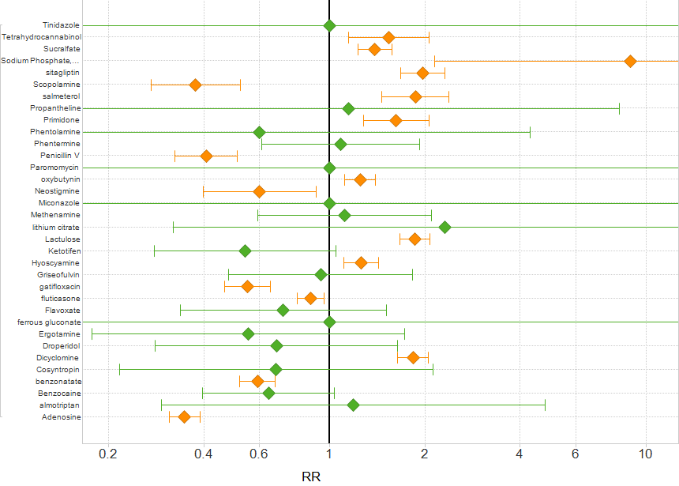
Reliability of estimated confidence intervals
Coverage prob. = 17 / 34 = 50%
34 negative controls
Notes:
Ryan PB, Stang PE, Overhage JM et al, Drug Safety, 2013: “A Comparison of the Empirical Performance of Methods for a Risk Identification System”
Acute liver injury, 34 negative controls
Cohort design to 34 negative controls for acute liver injury.
95%*34 = 32 of the estimates should cover RR = 1
Found 17 of negative controls did cover RR=1
Coverage prob. = 17 / 34 = 50%
Estimates on both sides of null suggest high variability in the bias

Slide 18
“Confidence intervals convey only error due to sampling variability around an unbiased estimator, but these databases provide extremely large samples that result in modest sampling variability. However, the true culprit in errant observational database studies is systematic error due to, for example, residual confounding and misclassification, which are not accounted for in traditional calculations… Furthermore, unlike sampling variability, systematic error does not diminish as sample size increases. The implication of this fact is that traditional statistical methods for controlling bias, e.g., covariate adjustment or matching, are failing, in these examples, to correct for bias.”
Madigan, D., Stang, P. E., Berlin, J. A., Schuemie, M., Overhage, J. M., Suchard, M. A., et al. (2014). A Systematic Statistical Approach to Evaluating Evidence from Observational Studies. Annual Review of Statistics and Its Application, 1(1), 11–39. http://doi.org/10.1146/annurev-statistics-022513-115645

Slide 19
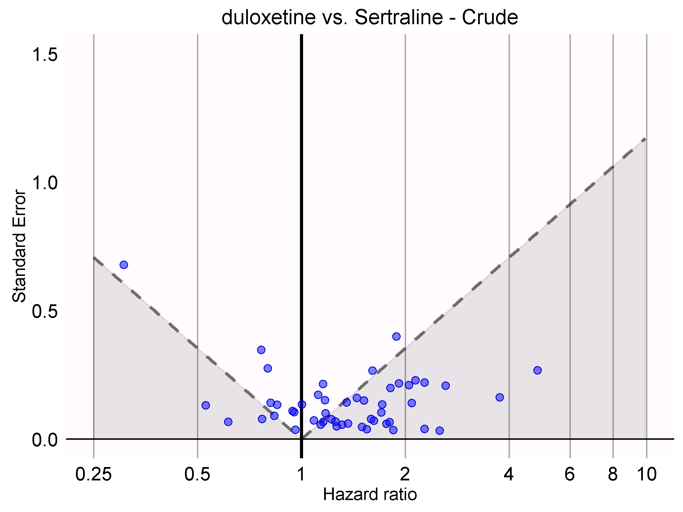
Calibration using negative controls
We would expect 5% of negative controls to have p < 0.05. Instead, 68% have p < 0.05!
Not statistically significant
Statistically significant
Notes:
We would expect 5% of negative controls to have p < 0.05
Instead, 68% has p < 0.05!

Slide 20
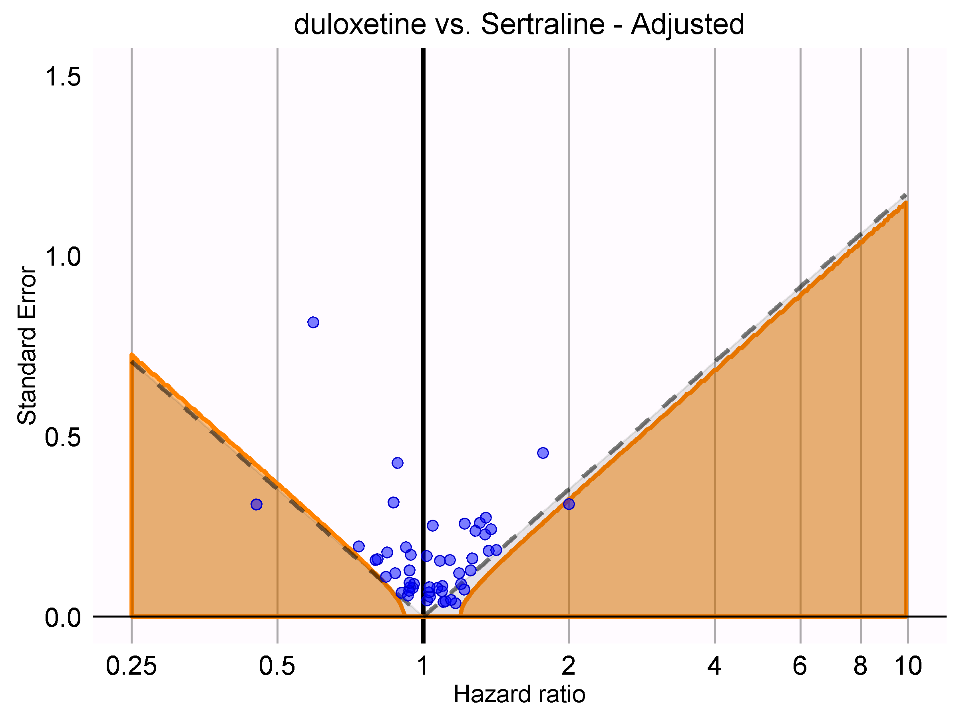
Calibration using negative controls
After calibration, 4% have p < 0.05
Calibrated p < 0.05

Slide 21
Calibration using negative controls:
Identify a set of K negative control exposure-outcome pairs
Using the same study design as for your main study, estimate the effect of each exposure and its corresponding negative outcome
The set of effect size estimates you get is your null distribution
Compute an empirical p-value by finding the percentage of the null effects that are greater than the effect you calculated for your study

Slide 22
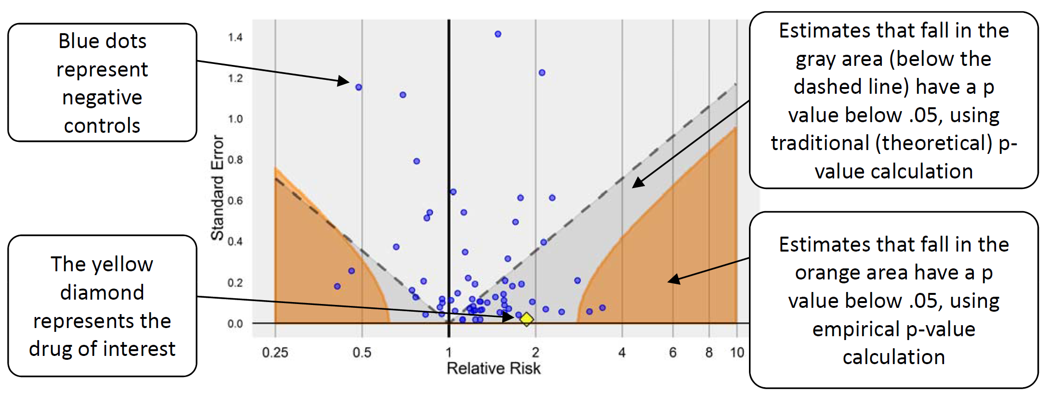
Empirical calibration to correct p-values
Negative controls can be used to estimate empirical null distribution, which can replace theoretical null to estimate calibrated p-value to test for statistical significance
Schuemie, M. J., Ryan, P. B., DuMouchel, W., Suchard, M. A., & Madigan, D. (2013). Interpreting observational studies: why empirical calibration is needed to correct p-values. Statistics in Medicine, 33(2), 209–218. http://doi.org/10.1002/sim.5925
Notes:
On testing known “negative” associations, using theoretical null: 55% of associations have p < .05 Using empirical null: 6% have p < .05 .
X-axis is the estimate of the strength of the association, Y-axis is the standard error of the estimate. Dotted lines show the p=0.05 cutoff, meaning that if the standard error is below that level for a given association strength, one can reject the null hypothesis and be wrong only 5% of the time. [for stronger associations, you can tolerate a larger standard error]

Slide 23
Theoretical hypothesis testing
Hypothetical
Data
x_{s} | y_{s}
0.12 | 12
… | …
19 | 1435
0.2 | 13
x_{s} | y_{s}
0.21 | 12.6
… | …
93 | 135
0.2 | 13
Y ~ 𝒩(θ₀x,σ²)
x_{s} | y_{s}
0.12 | 12
… | …
19 | 1435
0.2 | 13
x | y
0.12 | 12
… | …
19 | 1435
0.2 | 13
Estimate
^
sampling distribution of θ given θ = θ₀
^
θ
Notes:
Often you can calculate the sampling dist. under the null analytically
There are also ways to do this with the bootstrap

Slide 24
Using negative controls
Situation where we know there is no effect
real
data from same database
Situation where we know there is no effect
Situation where we know there is no effect
x_{s} | y_{s}
0.12 | 12
… | …
19 | 1435
0.2 | 13
Situation where we know there is no effect
x | y
0.12 | 12
… | …
19 | 1435
0.2 | 13
Situation where we know there is no effect
Situation where we know there is no effect
Situation where we know there is no effect
Our study
Estimate
Empirical p-value
^
θ
Notes:
Often you can calculate the sampling dist. under the null analytically
There are also ways to do this with the bootstrap

Slide 25
You are studying the impact a new device for mitral valve replacement vs. an older device. The outcome is 1-year readmissions for complications. What do you think would make for a good negative control in this study?
Notes:
Call on people, write their strategies on the board and organize them in a way that they reflect the next few slides

Slide 26
Good negative outcomes are as similar as possible to your exposure and outcome
Use the same exposure, look for negative control outcomes
Use the same outcome, look for negative control exposures
Lipsitch, M., Tchetgen Tchetgen, E., & Cohen, T. (2010). Negative controls: a tool for detecting confounding and bias in observational studies. Epidemiology, 21(3), 383–388. http://doi.org/10.1097/EDE.0b013e3181d61eeb

Slide 27
Empirical calibration to correct confidence intervals
Calibrating confidence intervals is a bit harder to do than the calibration of the p-value using negative controls
It requires that you “know” the true value of the thing you are trying to estimate.
We are not going discuss this.

Slide 28
Are we asking the right questions? Does any of this matter? How will this evidence be used in practice?
Preventing Type 3 errors!

Slide 29
Putting it all together
How to not be wrong

Slide 30
Question and Data
Is this exposure likely to be associated with this outcome?
What are the exposures that are associated with this outcome?
Notes:
Understand the question
Pick model(s) that are appropriate for your data
E.g. logistic vs. linear vs. mixed effects model
if you test for distribution, then that’s model selection
Select best model using out-of-sample error
Get inferences on a validation set or by bootstrapping though model selection
Use negative/positive controls to calibrate inferences for biases (requires you to conduct K more studies with your data)
Pick similar negative exposures-outcome pairs
Interpret results carefully
“changing one thing with everything else held constant” interpretation is only reasonable if variable is independent from the others…
What can we do with observational data to make the exposure independent from other variables?

Slide 31
Question and Data
Specify Models
Y ~ 𝒩(μ,σ²)
A model is a set of assumptions: encode your domain knowledge into the models you try
Outcome | Kind of analysis
 | Unadjusted | Adjusted
Continuous | t-test ANOVA | Linear regression
Categorical | chi-squared test Fisher exact test | logistic regression
Time-to-event | Log-rank test/ Kaplan-Meier curve | Cox proportional hazards regression
Notes:
Understand the question
Pick model(s) that are appropriate for your data
E.g. logistic vs. linear vs. mixed effects model
if you test for distribution, then that’s model selection
Select best model using out-of-sample error
Get inferences on a validation set or by bootstrapping though model selection
Use negative/positive controls to calibrate inferences for biases (requires you to conduct K more studies with your data)
Pick similar negative exposures-outcome pairs
Interpret results carefully
“changing one thing with everything else held constant” interpretation is only reasonable if variable is independent from the others…
What can we do with observational data to make the exposure independent from other variables?

Slide 32
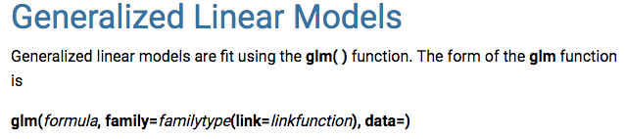
Question and Data
Specify Models
Fit Models
θ
σ
Use existing software to find parameter estimates for each model
Likelihood

Slide 33
Question and Data
Specify Models
Fit Models
Select Model
Select model using an estimate of out-of-sample error (i.e. test set error)

Slide 34
Question and Data
Specify Models
Fit Models
Select Model
Inference
Find confidence intervals and p-values using a different sample, or bootstrap across model selection
sampling distribution of θ given θ = θ₀
^
θ

Slide 35
Question and Data
Specify Models
Fit Models
Select Model
Empirical Calibration
Inference
Use negative controls to calibrate inferences
Notes:
Understand the question
Pick model(s) that are appropriate for your data
E.g. logistic vs. linear vs. mixed effects model
if you test for distribution, then that’s model selection
Select best model using out-of-sample error
Get inferences on a validation set or by bootstrapping though model selection
Use negative/positive controls to calibrate inferences for biases (requires you to conduct K more studies with your data)
Pick similar negative exposures-outcome pairs
Interpret results carefully
“changing one thing with everything else held constant” interpretation is only reasonable if variable is independent from the others…
What can we do with observational data to make the exposure independent from other variables?

Slide 36
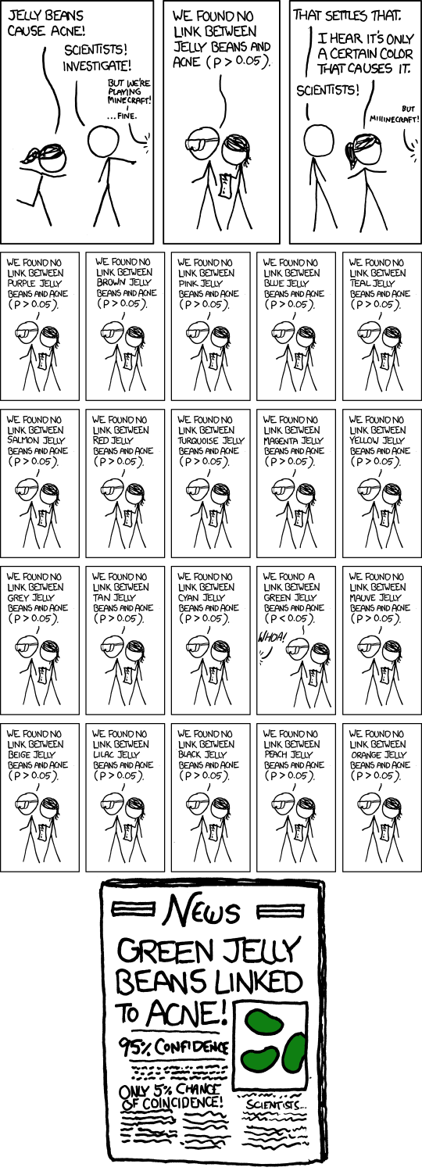
Question and Data
Specify Models
Fit Models
Select Model
Empirical Calibration
Inference
Multiple Hypothesis Correction
Correct for multiple hypotheses if necessary
Notes:
Understand the question
Pick model(s) that are appropriate for your data
E.g. logistic vs. linear vs. mixed effects model
if you test for distribution, then that’s model selection
Select best model using out-of-sample error
Get inferences on a validation set or by bootstrapping though model selection
Use negative/positive controls to calibrate inferences for biases (requires you to conduct K more studies with your data)
Pick similar negative exposures-outcome pairs
Interpret results carefully
“changing one thing with everything else held constant” interpretation is only reasonable if variable is independent from the others…
What can we do with observational data to make the exposure independent from other variables?

Slide 37
Question and Data
Specify Models
Fit Models
Select Model
Empirical Calibration
Inference
Multiple Hypothesis Correction
Interpret Result
What does the parameter mean?
Do your variables change independently of each other?
“A change in one variable, all others held constant”
Notes:
Understand the question
Pick model(s) that are appropriate for your data
E.g. logistic vs. linear vs. mixed effects model
if you test for distribution, then that’s model selection
Select best model using out-of-sample error
Get inferences on a validation set or by bootstrapping though model selection
Use negative/positive controls to calibrate inferences for biases (requires you to conduct K more studies with your data)
Pick similar negative exposures-outcome pairs
Interpret results carefully
“changing one thing with everything else held constant” interpretation is only reasonable if variable is independent from the others…
What can we do with observational data to make the exposure independent from other variables?

Slide 38
Question and Data
Specify Models
Fit Models
Select Model
Empirical Calibration
Inference
Multiple Hypothesis Correction
Interpret Result
Next time: can we do anything to existing data to get independence between our exposure and other variables?
If we can do that, then we get causal effects
Notes:
Understand the question
Pick model(s) that are appropriate for your data
E.g. logistic vs. linear vs. mixed effects model
if you test for distribution, then that’s model selection
Select best model using out-of-sample error
Get inferences on a validation set or by bootstrapping though model selection
Use negative/positive controls to calibrate inferences for biases (requires you to conduct K more studies with your data)
Pick similar negative exposures-outcome pairs
Interpret results carefully
“changing one thing with everything else held constant” interpretation is only reasonable if variable is independent from the others…
What can we do with observational data to make the exposure independent from other variables?

Slide 39
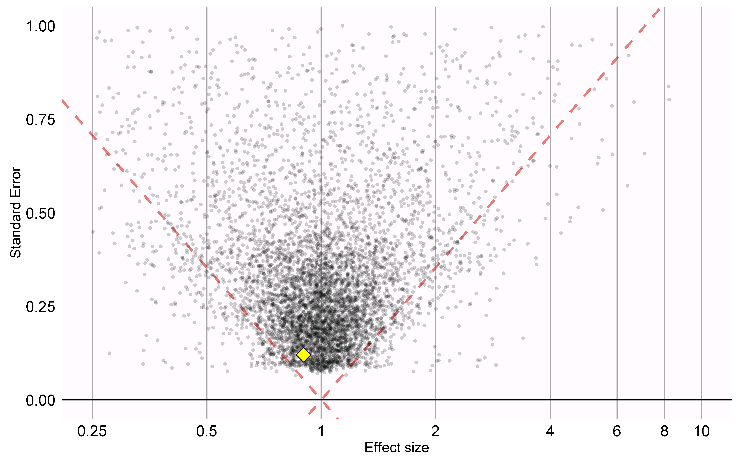
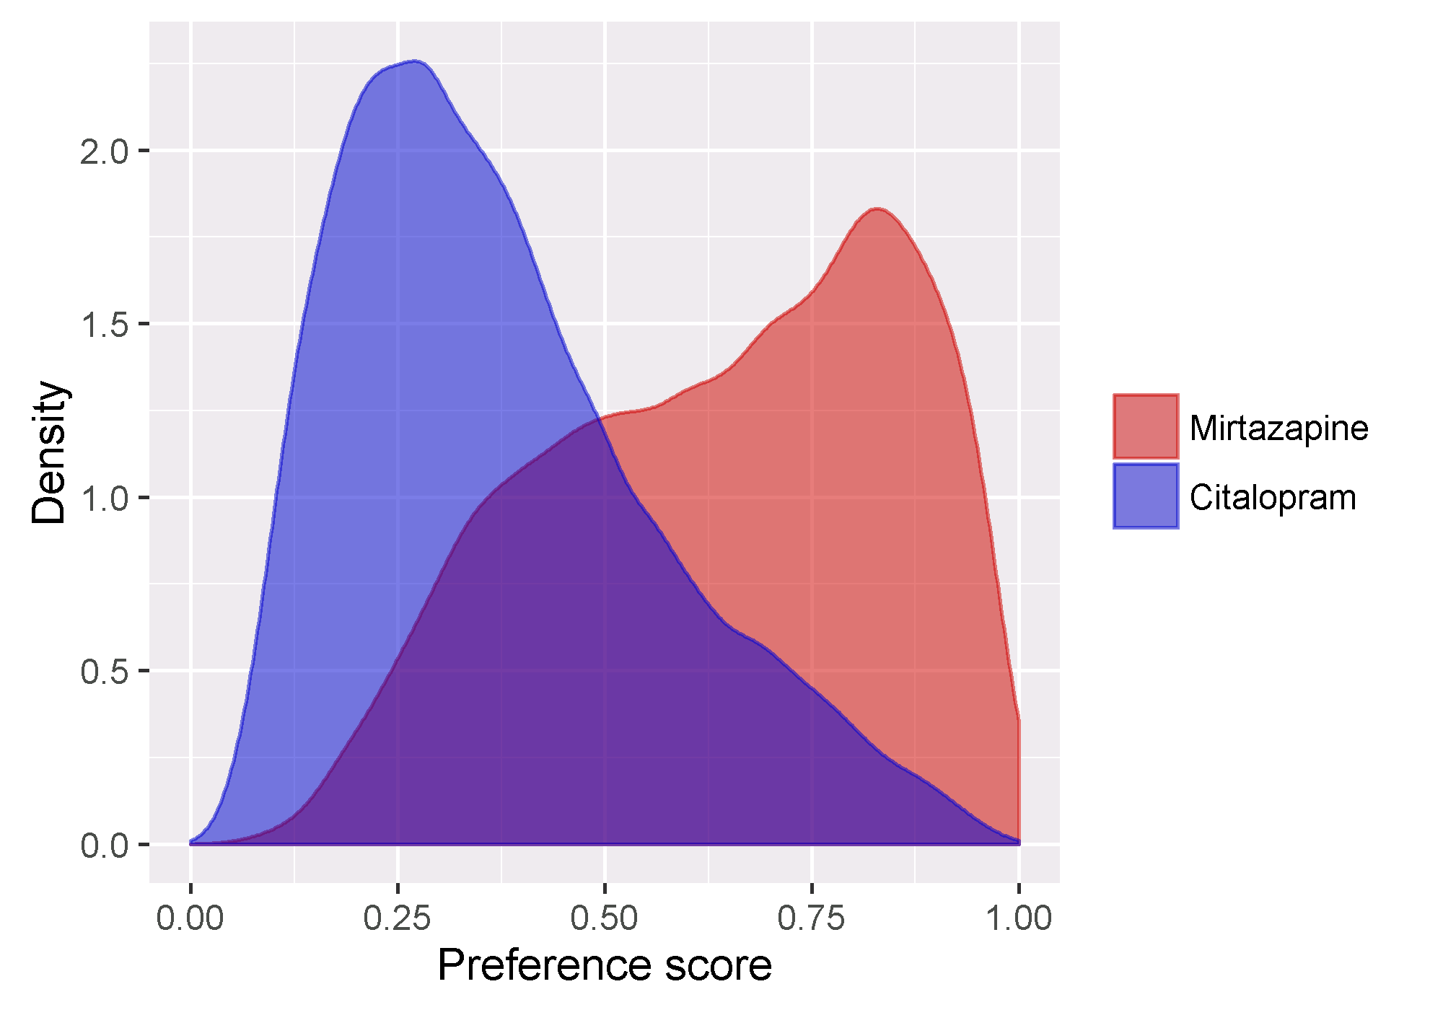
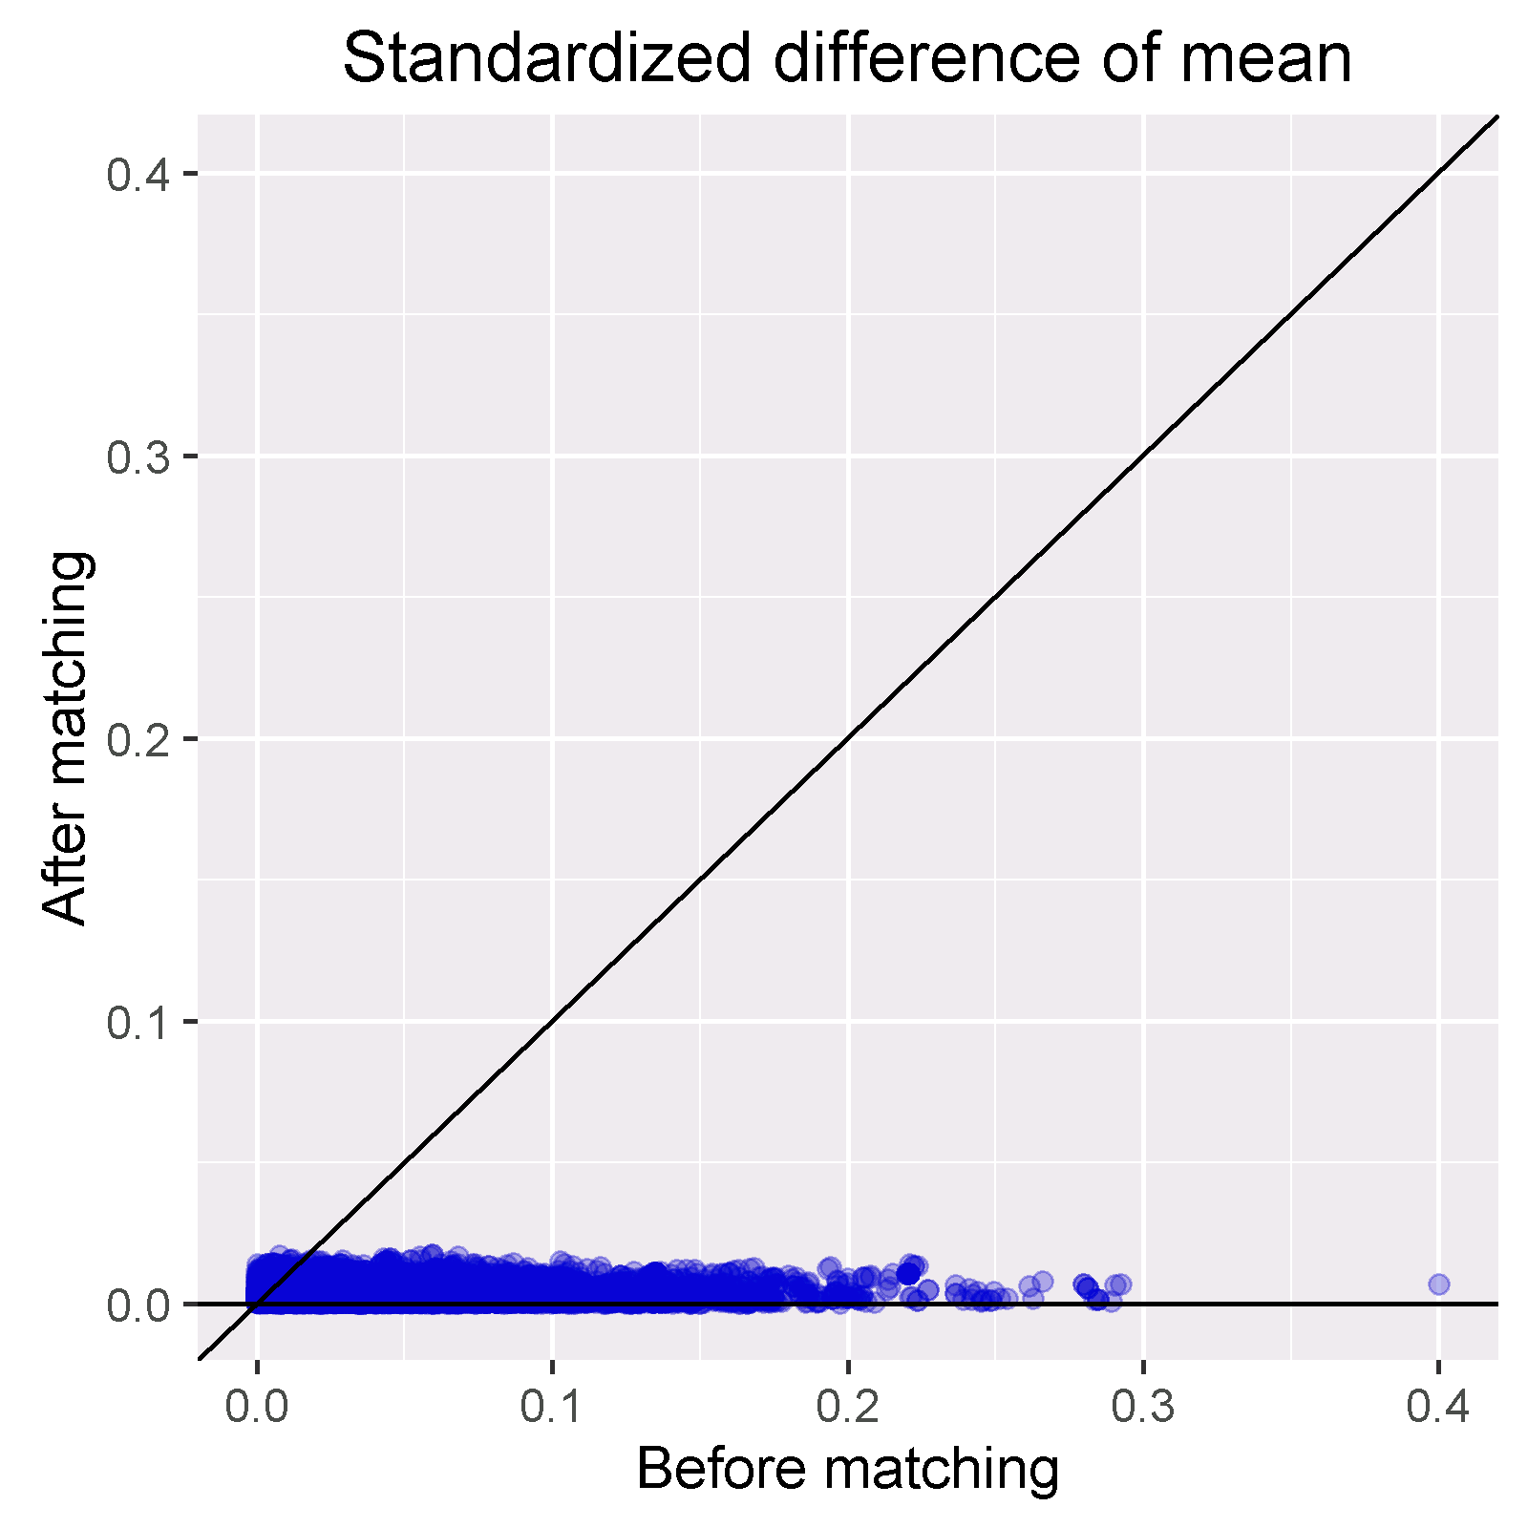
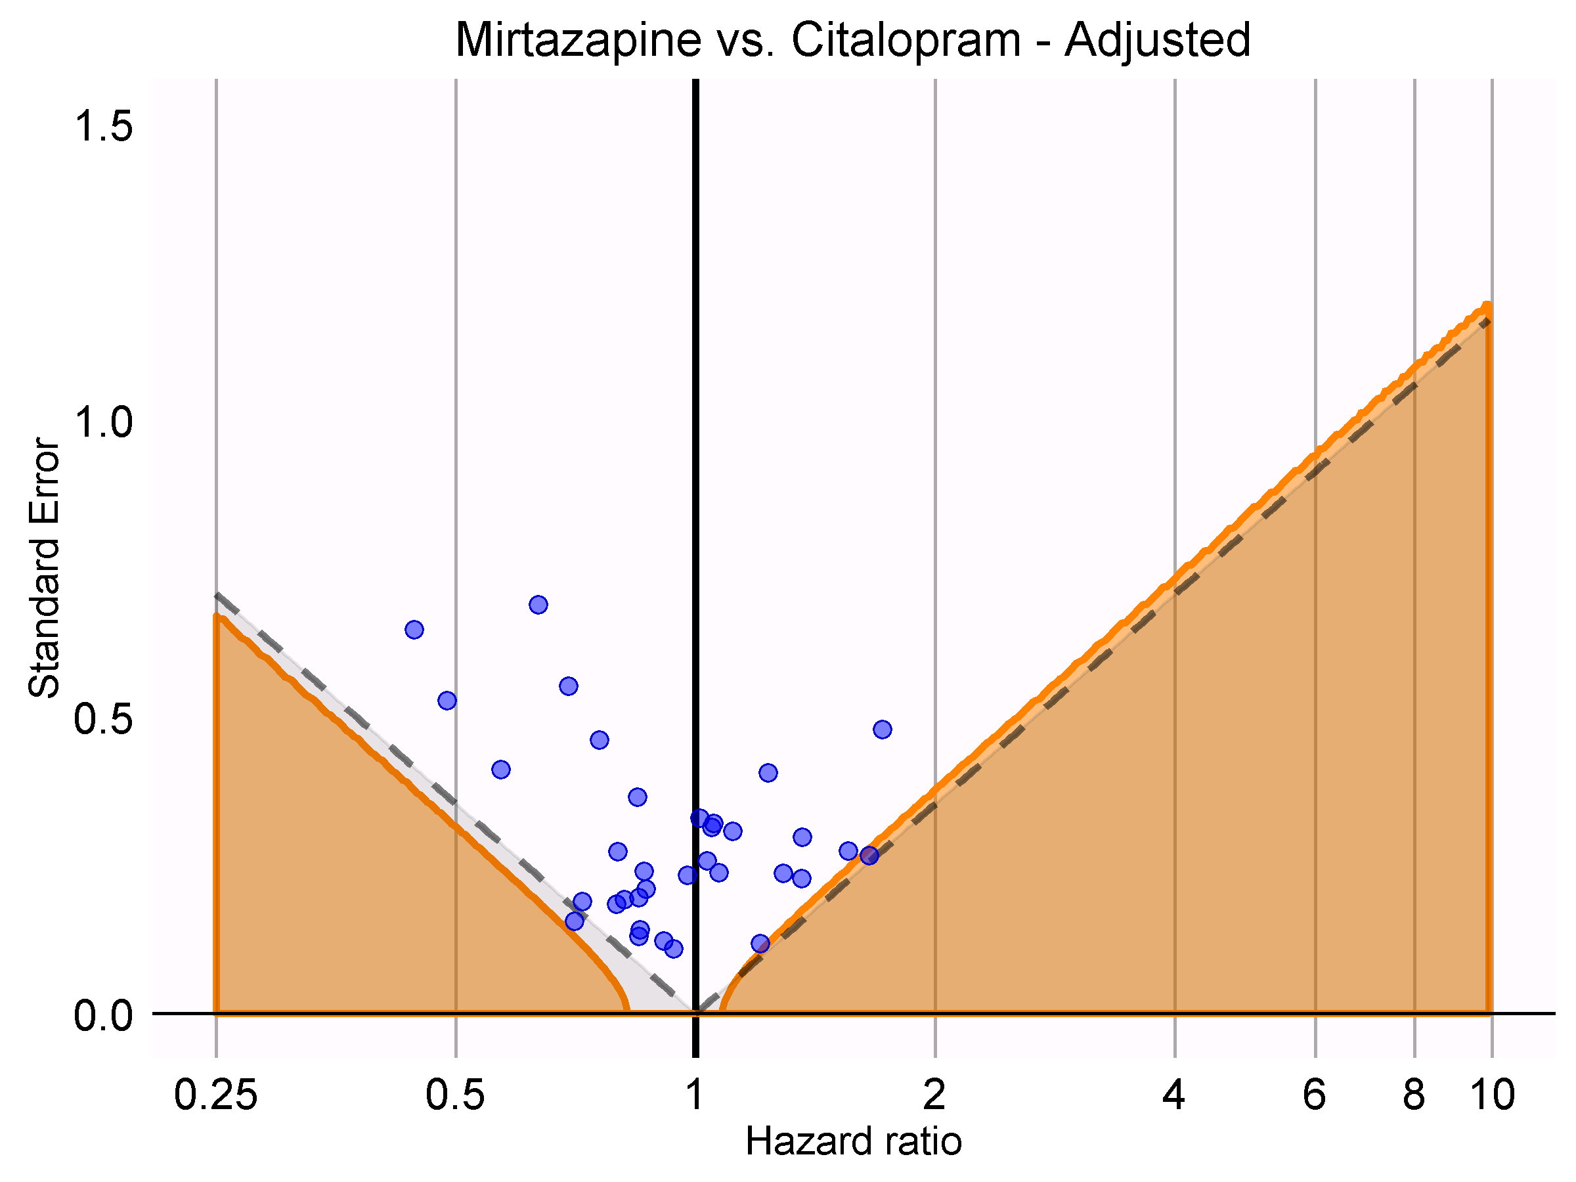
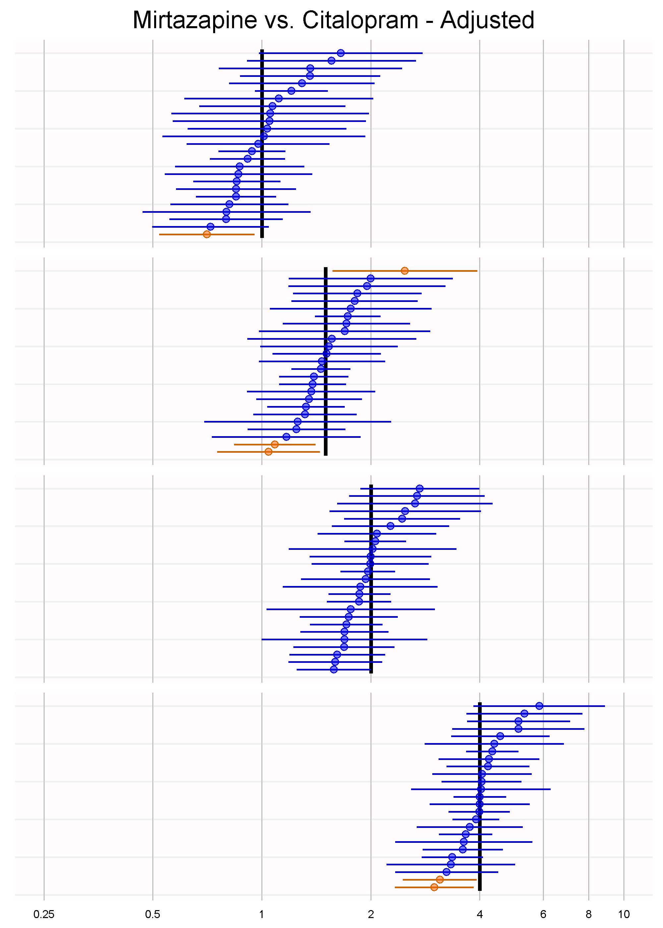
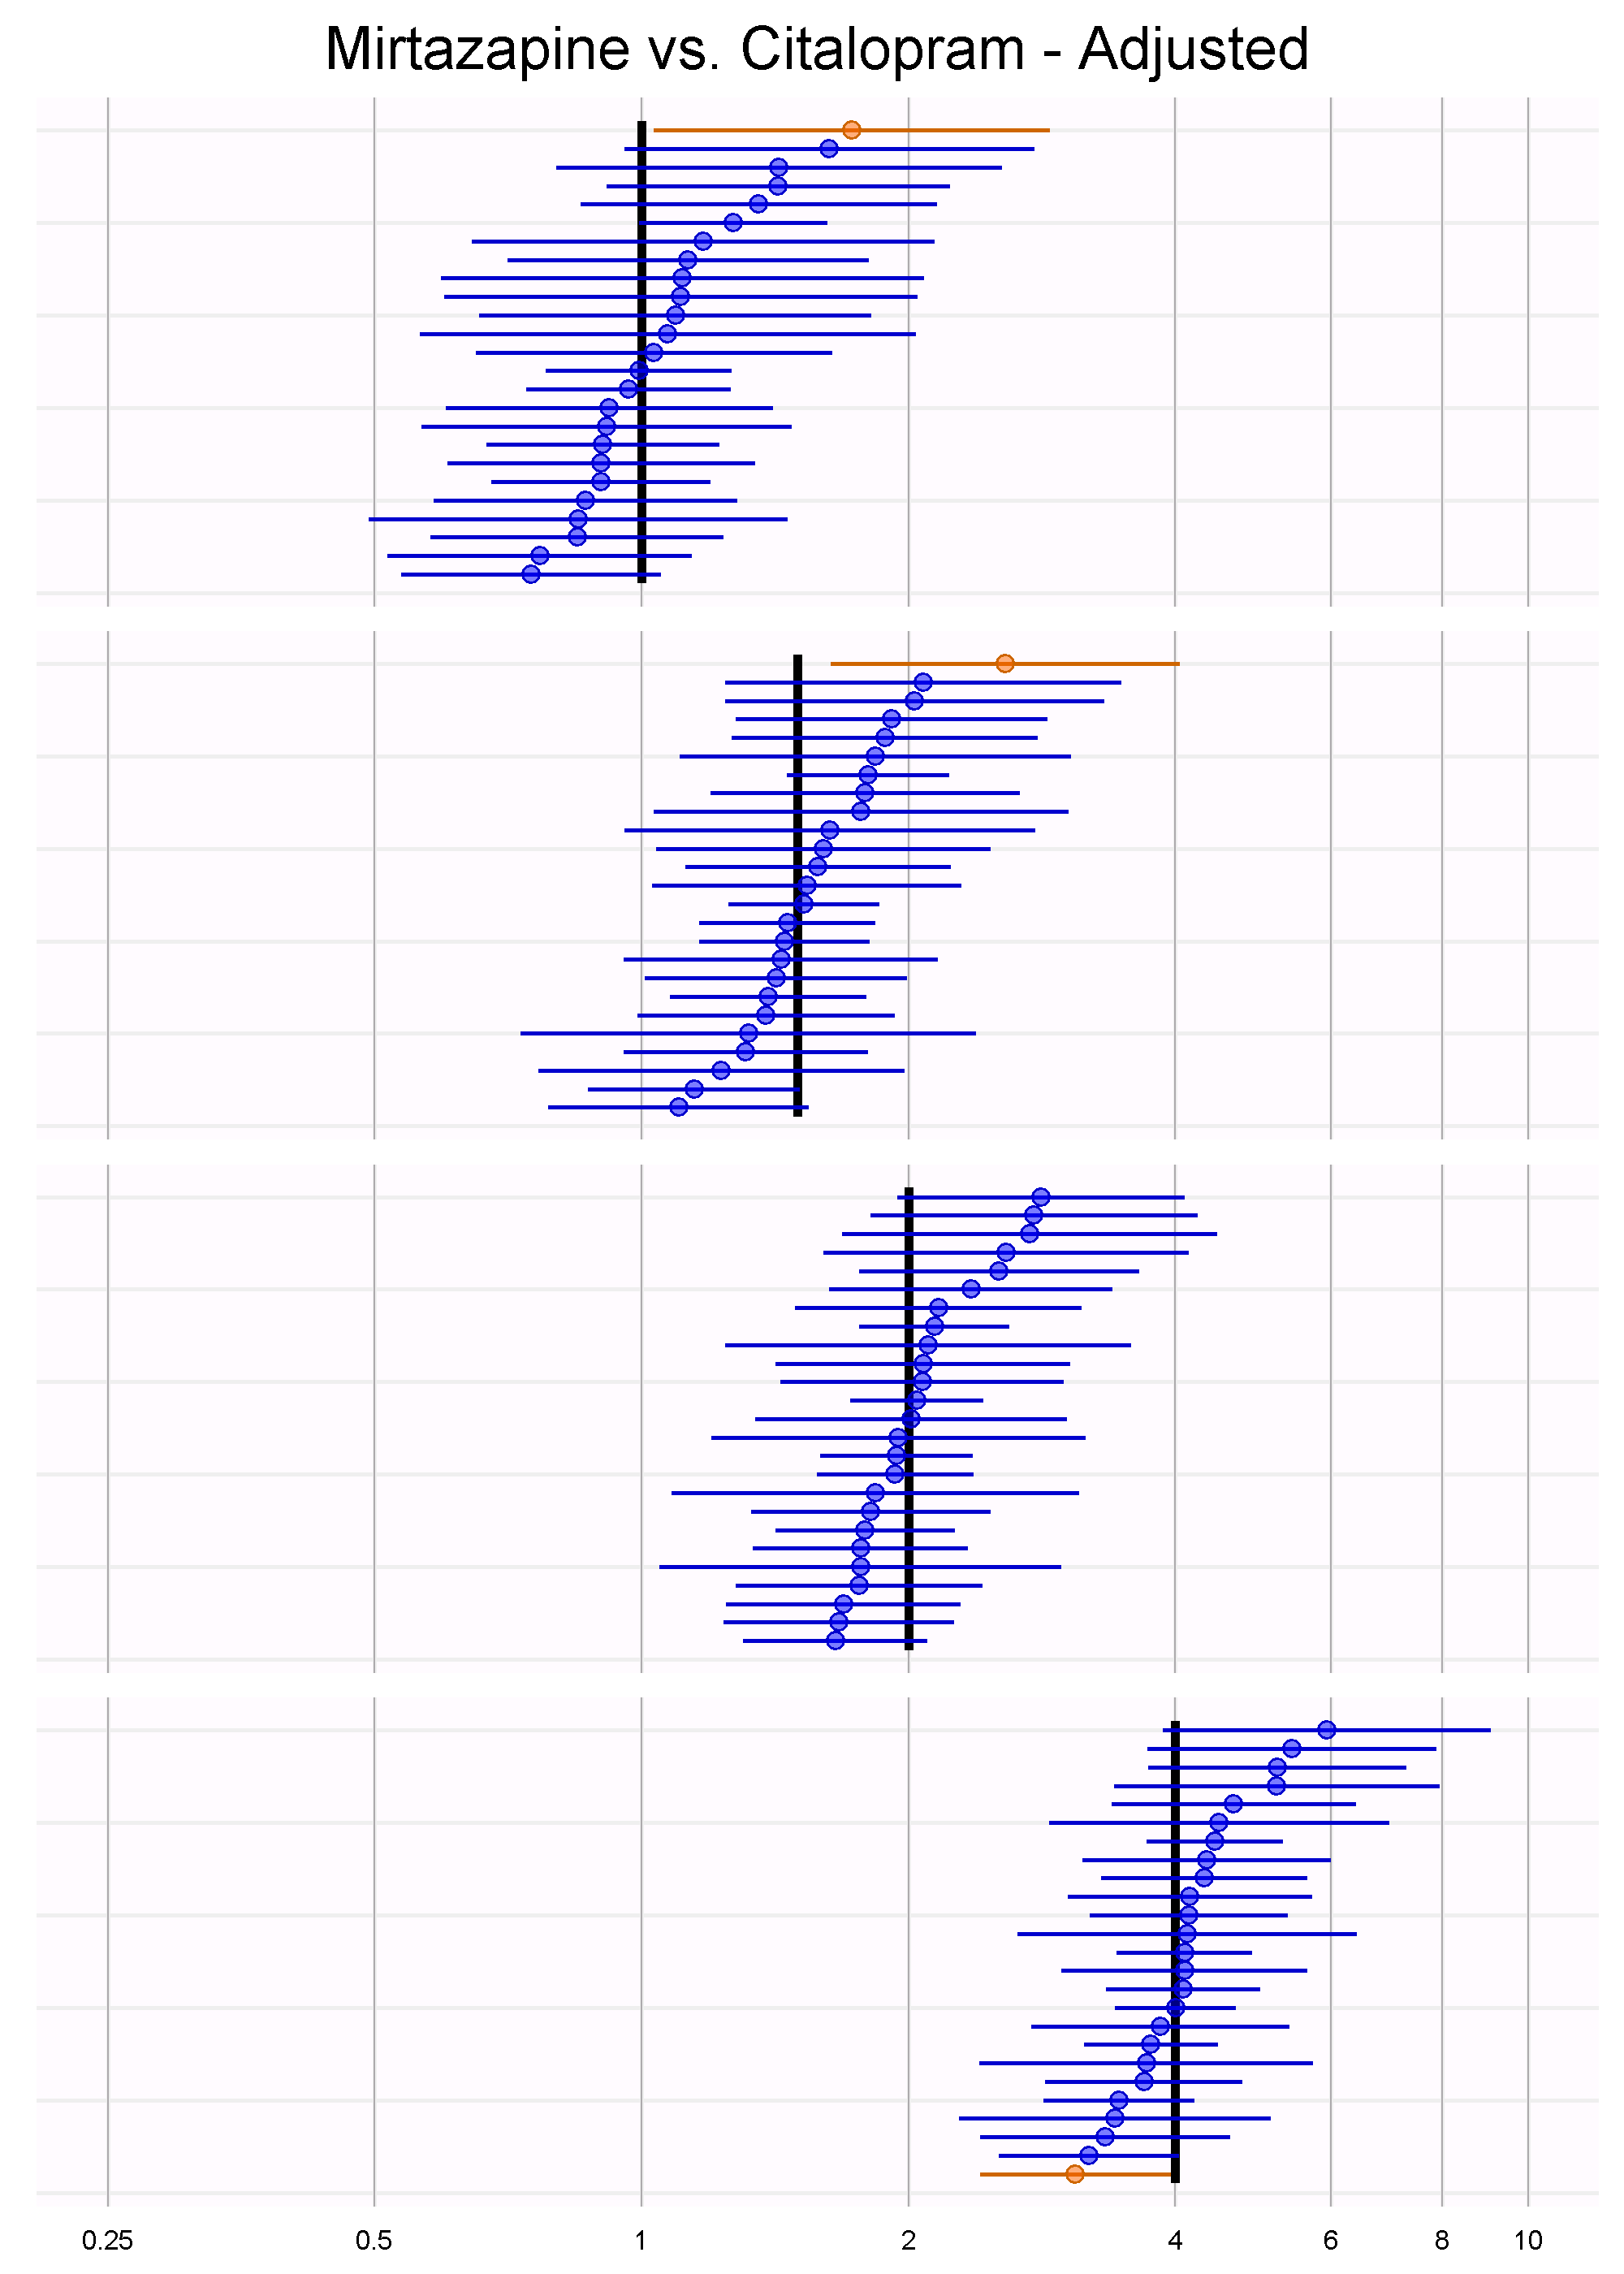
Example in practice
Mirtazapine vs. Citalopram
Constipation
Database: Truven MDCD
Calibrated HR = 0.90 (0.70 – 1.12)

Slide 40
Remember:
Use out-of-sample error to select between models, but be aware that model selection breaks inference
Use positive/negative controls to calibrate for systematic biases in the data
Think about how the evidence will be used in practice

